Slide 1
SNAP MAP
Team: Donuts and Data Division
Ari Anisfeld, Jasmin Dial, Emma Peterson, Joan Wang

Slide 2
Agenda
Goal
Outcome
Technical details
Data sources
App structure
Struggles and lessons
Future improvements

Slide 3
Where we started
Create a tool that eases the process of locating and utilizing community-resources for low-income individuals.

Slide 4
Goal
Focus on locating retailers that accept SNAP (Supplemental Nutrition Assistance Program) benefits
Create tool that helps users optimize value of SNAP benefits

Slide 5
DEMO TIME!

Slide 6
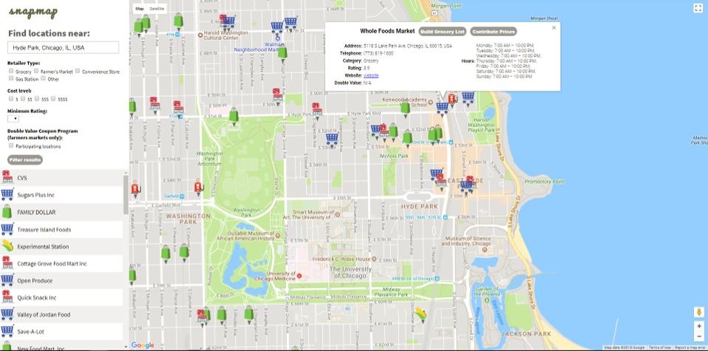

Slide 7
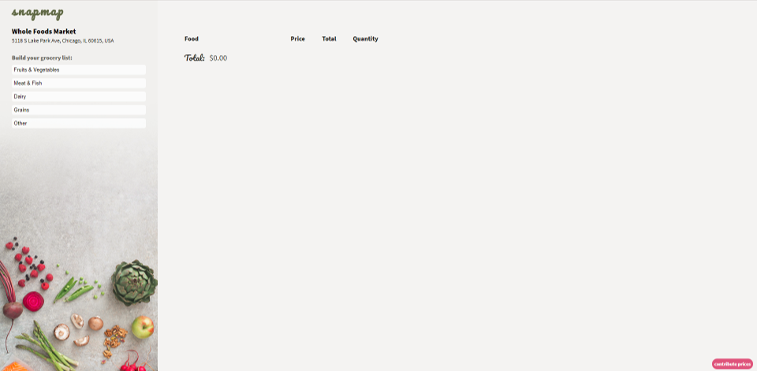

Slide 8
Outcome – Mapping
Improved accuracy of retailer information
Additional information when available
Search/filter options
Flexible geographic search options through SpatiaLite
Improved Farmer’s Market data

Slide 9
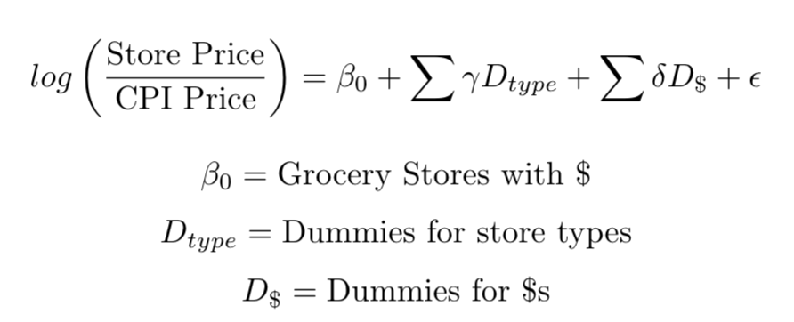
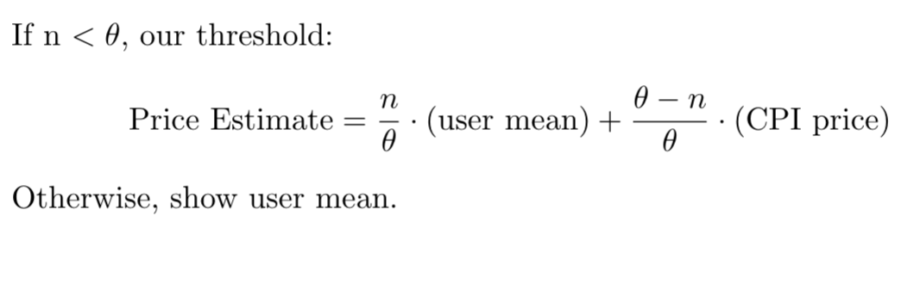
Outcome – Grocery List & Price Contributions
More specific price estimates
Dimensions: store type & price level
Field research
Regression to estimate multipliers
User-contributed prices to improve accuracy

Slide 10
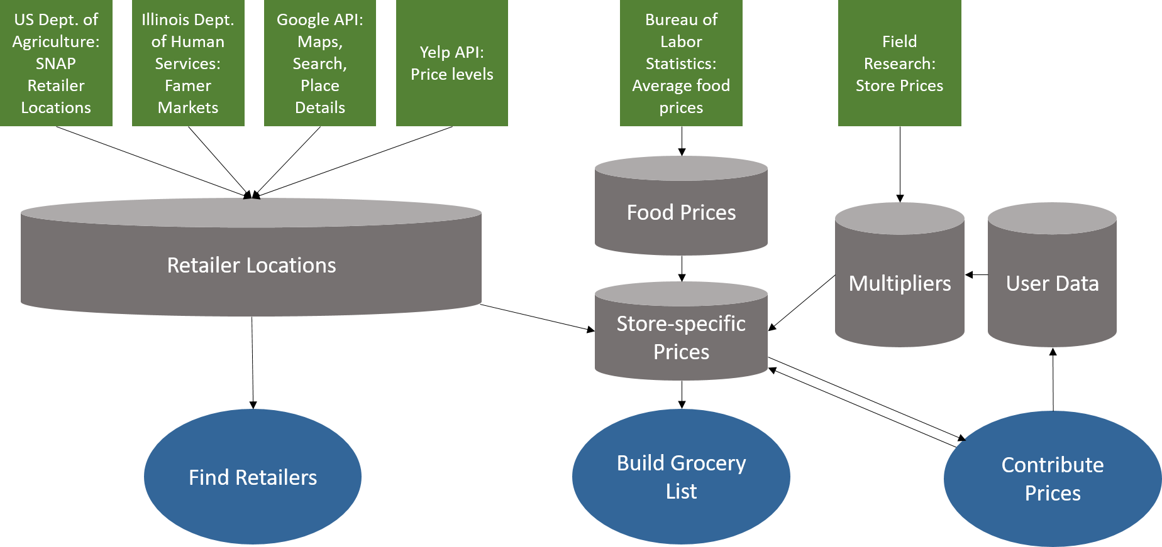
Structure

Slide 11

Challenge: Record Linkage

Slide 12
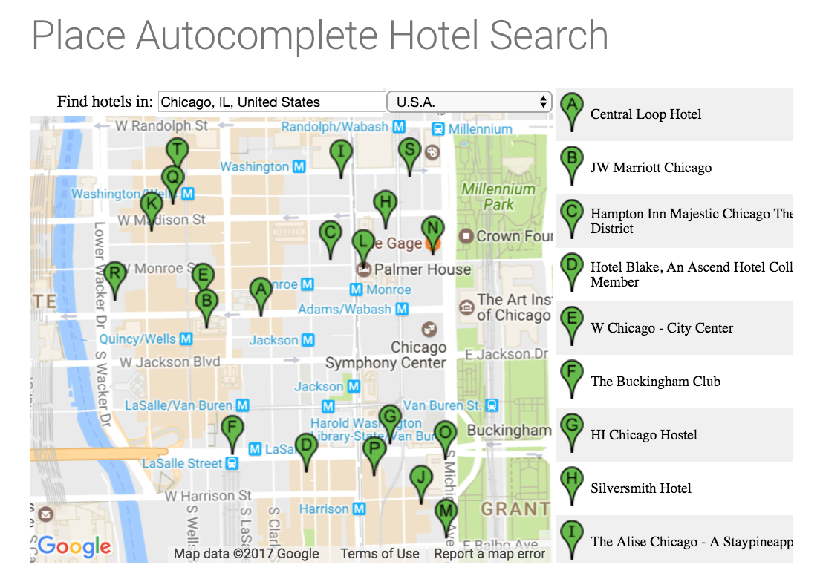
Challenge: Google API + Javascript

Slide 13
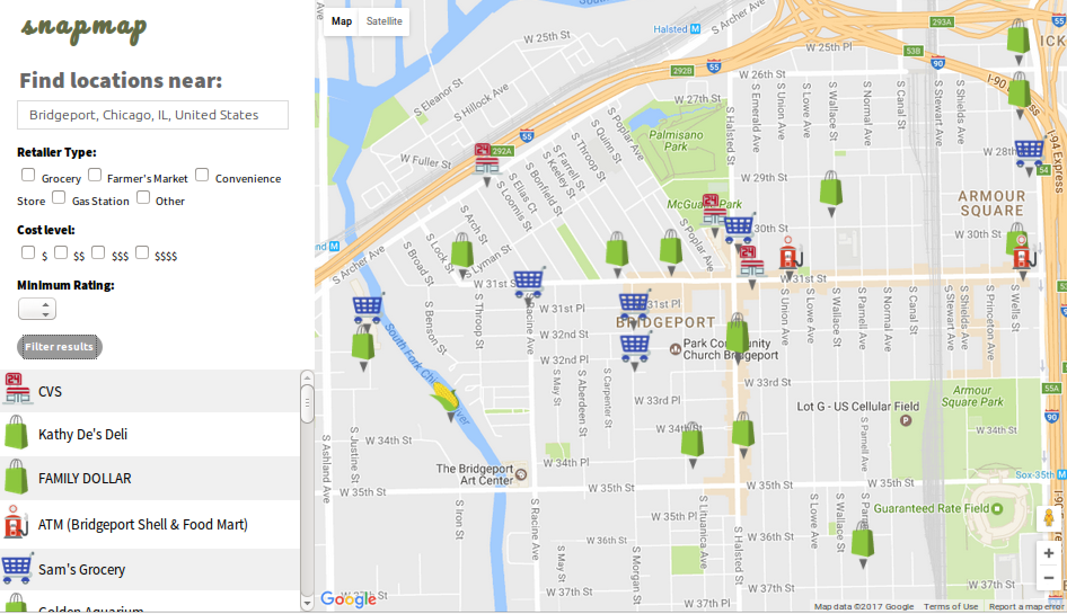
Challenge: How to get a map to speak to a database

Slide 14
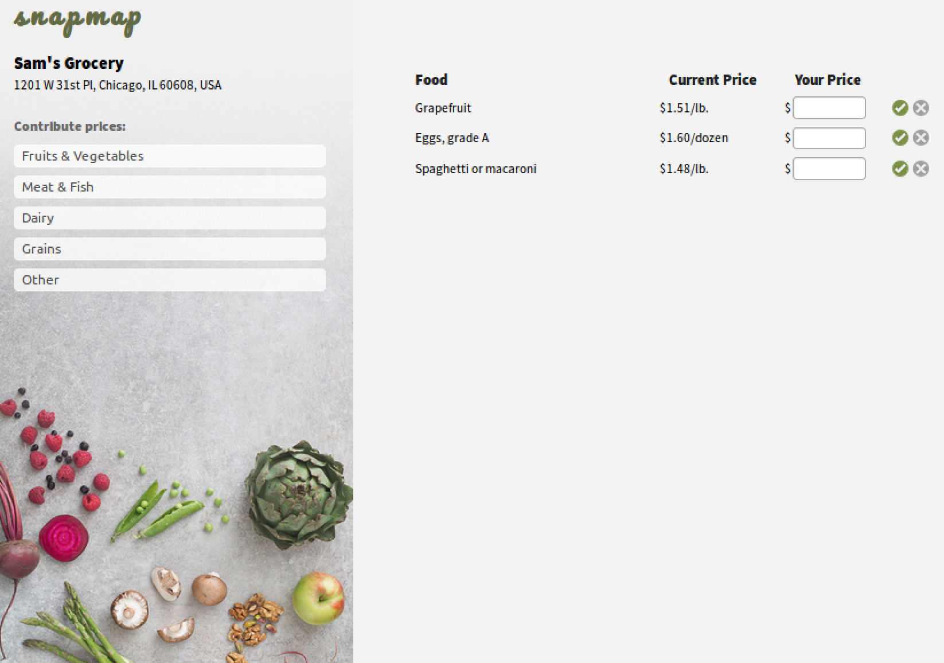
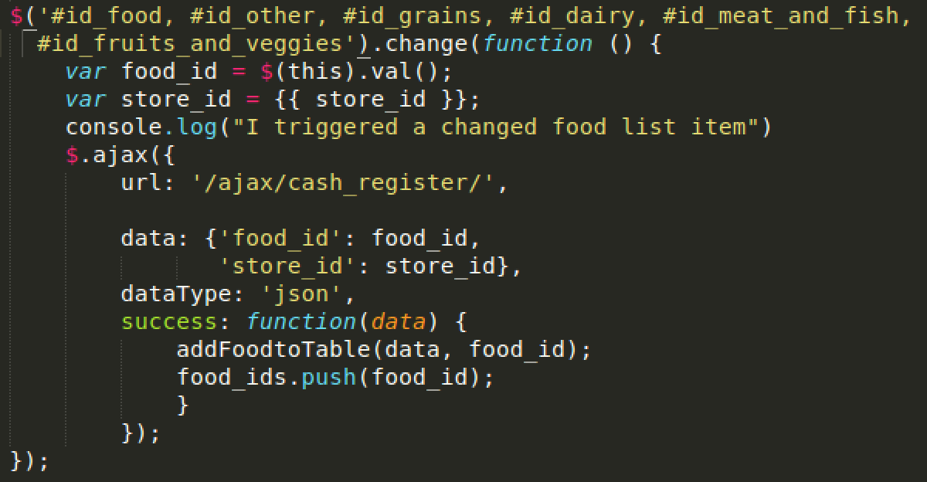
Challenge: FrontEnd to BackEnd Communication

Slide 15
Future of snapmap
Improved accuracy of retailer information
Leverage user input for important features
Tailored grocery list
More field research
Expand to other cities
Automatic refreshing of source data
Migrate to PostGre/PostGIS and make site public

Slide 16
Questions? Input?

